Slide 1
Unpaired Image-to-Image Translation using Cycle-Consistent Adversarial Networks
Authors: Jun-Yan Zhu*, Taesun Park*, Phillip Isola, Alexei A. Efros
Published in ICCV 2017
Presented by Ying Meng
Notes:
<number>

Slide 2
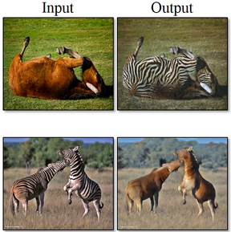
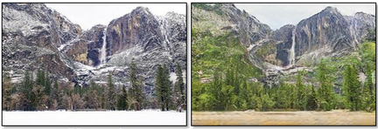
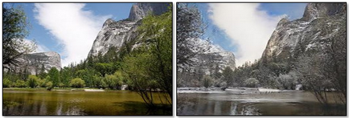
Highlights
Collection Style Transfer
Object
Transfiguration
Season Transfer
Notes:
<number>

Slide 3
Outline
GAN
Random generator
G(z) and D(x)
cGAN
Pix2pix
Cycle Consistency
CycleGAN
Notes:
<number>

Slide 4
GAN (Ian Goodfellow et al., NIPS 2014)
Overview
X
Real world samples
D
D(x)
⃝ ----- ⃝
Discriminator
Loss
z
G(z)
⃝ ⃝⃝
D(G(z))
Generator
Credit(modified from) https://www.slideshare.net/xavigiro/deep-learning-for-computer-vision-generative-models-and-adversarial-training-upc-2016
Notes:
<number>

Slide 5
GAN (Ian Goodfellow et al., NIPS 2014)
Training Discriminator
Backprop error to update θ_{d} to maximize
X
P_{data}(x)
Real world samples
D(x, θ_{d})
⃝ ----- ⃝
(D)iscriminator
Loss
z
⃝ ⃝⃝
(G)enerator
D(G(z), θ_{g})
G(z)
P(G(z))
=
P_{prior}(z)
Credit(modified from) https://www.slideshare.net/xavigiro/deep-learning-for-computer-vision-generative-models-and-adversarial-training-upc-2016
Notes:
<number>

Slide 6
GAN (Ian Goodfellow et al., NIPS 2014)
Training Generator
=
X
P_{data}(x)
Real world samples
D(x, θ_{d})
⃝ ----- ⃝
(D)iscriminator
Loss
z
⃝ ⃝⃝
(G)enerator
D(G(z), θ_{g})
Backprop error to update θ_{g} to minimize
P_{prior}(z)
G(z)
P(G(z))
Credit(modified from) https://www.slideshare.net/xavigiro/deep-learning-for-computer-vision-generative-models-and-adversarial-training-upc-2016
Notes:
<number>

Slide 7
GAN (Ian Goodfellow et al., NIPS 2014)
Objective
Maximize D
Value of
Expectation
fake
Minimize G
Distribution of real data
Prob. Of D(real)
Distribution of generated samples
Prob. Of D(fake)
Notes:
<number>

Slide 8
Outline
GAN
cGAN
Condition with some vector y
G(x, y) and D(x, y)
Pix2pix
CycleGAN
Summary
Notes:
<number>

Slide 9
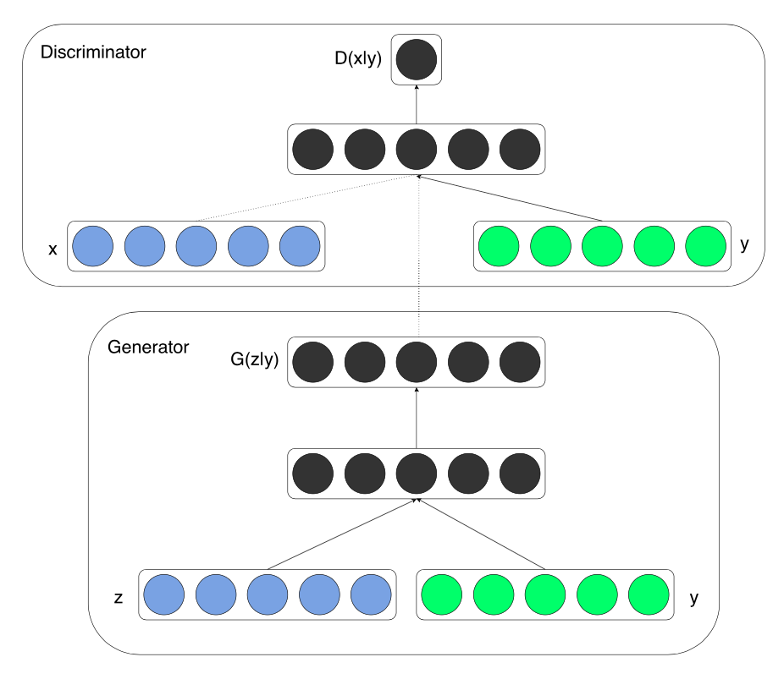
cGAN (Mehdi et al., 2014)
Condition the GAN with some vector y.
See the networks with a probabilistic point of view.
Generator G(z, y)
modeling the distribution of data given z and y
Discriminator D(x, y)
Labels X and X_{G} are modeled with d ~ D(d|X, y)
Objective function
Credit: https://arxiv.org/pdf/1411.1784.pdf
Notes:
<number>

Slide 10
Outline
GAN
cGAN
Pix2pix
z = x
Paired image-to-image translator
Adversarial is on image level
CycleGAN
Summary
Notes:
<number>

Slide 11
pix2pix (Phillip Isola et al., CVPR 2017)
Generator G(x) – generate the synthesized pair for given image x
Discriminator D(<x, G(x)>)
Paired
Credit: http://openaccess.thecvf.com/content_cvpr_2017/papers/Isola_Image-To-Image_Translation_With_CVPR_2017_paper.pdf
Notes:
Pix2pix, an image-to-image translator
It is a cGAN, where the input of the Generator is real image rather than just some latent vector.
In this model, The Generator is trained to fool the discriminator, by generating some image in domain Y given some image in domain X. For example, mapping edges to photo, or mapping sketch to painting. The Discriminator is trained to classify between fake (the generated image) and the real (the input of the Generator) tuples. So, we can see that the adversarial is on image level in pix2pix.
<number>

Slide 12
Outline
GAN
cGAN
Pix2pix
CycleGAN
Architecture
Cycle Consistency
Implementation
Results
Limitations
Summary
Notes:
<number>

Slide 13
CycleGAN – Architecture
G
G: X -> Y
GAN (Y2X) loss
GAN (X2Y) loss
D_{X}
X
Y
D_{Y}
Cycle consistency loss
F: Y -> X
Cycle consistency loss
F
Notes:
cycleGAN is a variant of GAN that learns the translation/conversion between two sets of data source, these two sets of data source (they called two domains) do not correspond to each other.
The networks contain two generators and two discriminators.
The generator G translates an image in domain X to an image in domain Y.
The discriminator Dy determines whether the input is from domain Y or is generated by the generator G.
And vice versa the generator F and the discriminator Dx.
<number>

Slide 14
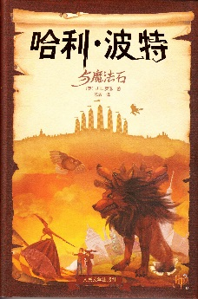
Cycle Consistency
Obviously, we expected
EN -> G(EN) -> F(G(EN)) ~ EN
Formalized,
if G: X -> Y, F: Y -> X; expect,
X -> G(X) -> F(G(X)) ~ X
EN
Translator G: English -> Chinese
CN
CN
EN’
Cycle-consistency loss
Translator F:
Chinese -> English
EN’
Notes:
<number>

Slide 15
CycleGAN – Objective Function
Full objective
Aim to solve
Adversarial loss (for G: X -> Y)
Cycle-consistency loss
Credit: https://arxiv.org/pdf/1703.10593.pdf
Notes:
Swapping X/x and Y/y can get the adversarial loss for F: Y -> X
Lgan(G, Dy, X, Y) – how much you can distinguish Y (an input) from the real Y and the generated Y with the discriminator Dy
Lgan(G, Dx, Y, X) – how much you can distinguish X (an input) from the real X and the generated X with the discriminator Dx
Lcyc(G, F) – distance between X and the re-constructed X (F(G(X))) + the distance between Y and the re-constructed Y (G(F(Y)))
<number>

Slide 16
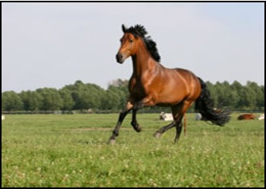
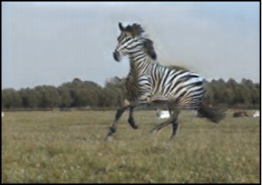
CycleGAN – Implement
Generator network
6 blocks for 128 x 128 images
c7s1-32, d64, d128, R128, R128, R128, R128, R128, R128, u64, u32, c7s1-3
9 blocks for 256 x 256 and higher resolution images
c7s1-32, d64, d128, R128, R128, R128, R128, R128, R128, R128, R128, R128, u64, u32, c7s1-3
encoding
transforming
decoding
Conv layer #1
Conv layer #2
Residual block #1
Residual block #2
Residual block #n
Conv layer #1
Conv layer #2
input
output
Notes:
C7s1-k denote a 7x7 Convolution-InstanceNorm-ReLU layer with k filters and stride 1.
Dk denotes a 3x3 Convolution-InstanceNorm-ReLU layer with k filters and stride 2.
Reflection padding was used to reduce artifacts.
Rk denotes a residual block that contains two 3x3 convolutional layers with the same number of filters on both layer.
Uk denotes a 3x3 Fractional-Strided-Convolution-InstanceNorm-ReLU layer with k filters and stride ½.
<number>

Slide 17
CycleGAN – Implementation
Discriminator network
70x70 PatchGAN
c64, c128, c256, c512
Credit: https://affinelayer.com/pix2pix/
Notes:
<number>

Slide 18
CycleGAN – Results
Applications
Analysis
Notes:
Check the paper
Images
Analysis
<number>

Slide 19
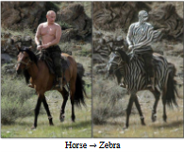
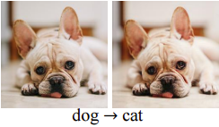
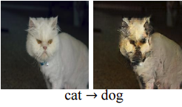
CycleGAN – Limitations
Changes in distribution characteristics (test set vs. training set)
Tasks require
geometric changes
A lingering gap between the results achievable from pix2pix and that achieved by CycleGAN.
https://qiita.com/itok_msi/items/b6b615bc28b1a720afd7#%E8%BF%BD%E5%8A%A0%E5%AE%9F%E9%A8%93%E7%B5%90%E6%9E%9C20170614%E8%BF%BD%E8%A8%987
Notes:
<number>

Slide 20
Outline
GAN
cGAN
Pix2pix
CycleGAN
Summary
Notes:
<number>

Slide 21
Summary
https://www.youtube.com/watch?v=AxrKVfjSBiA or
https://www.youtube.com/watch?v=D4C1dB9UheQ
Notes:
Play video
<number>

Slide 22
Notes:
<number>

